Slide 1

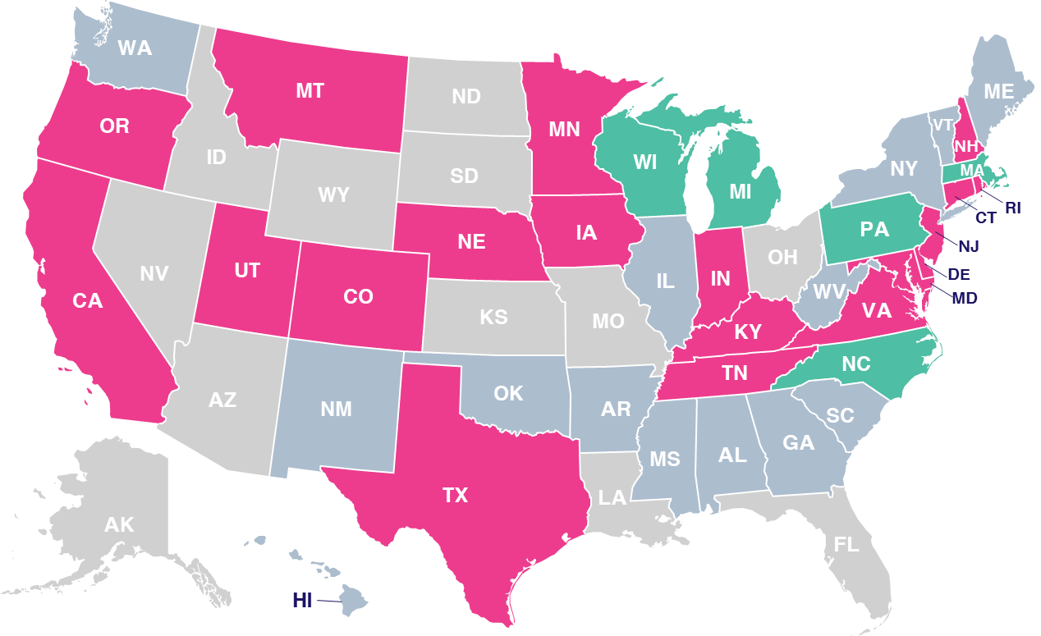
Data Privacy Map by State
Scan or click to access more data privacy insights
The data privacy landscape across the U.S. varies, with a number of new legislative acts being implemented by states
U.S. State Privacy Legislation Tracker
Legend
=Law Passed & Signed
(19 states)
=Active Bill In Committee
(5 states)
=Inactive Bill
(14 states)
=No Comprehensive Bill ..Introduced Yet
(12 states)
Click here to download the full report, ‘Understanding the Momentum of Data Privacy Legislation’ to learn more
Source: IAPP, ‘US State Privacy Legislation Tracker,’ as of 7/7/25.
theVAB.com/insights

