Slide 1

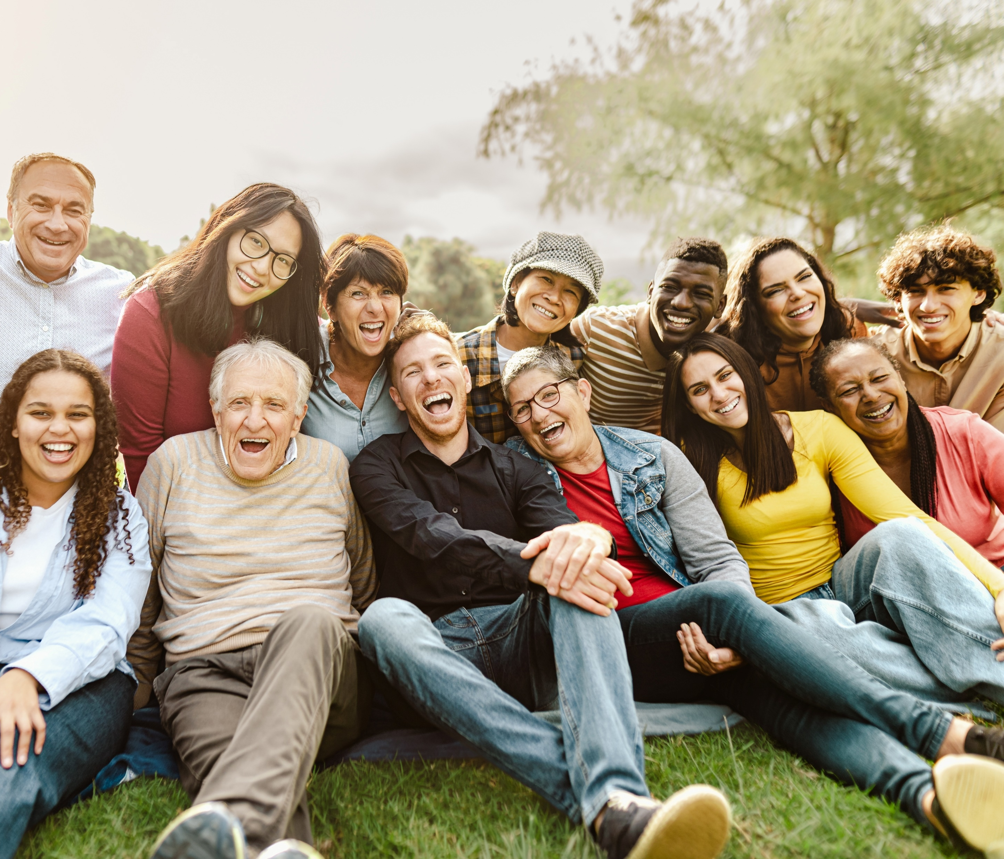
Representation in Advertising: Across Age Demos
Scan or click to access more life stage insights
Consumers across all age demographics are more likely to buy from brands that include ‘people like me’ in their ads
% of respondents who agree with the following statement
by age
‘I am more likely to purchase from brands who include people my age in their advertising’
57% / 58% / 63% / 61%
Source: VAB analysis of MRI-Simmons Q2 2024 Trending Topics Study, A18+. Reflects respondents who answered ‘somewhat agree’ or ‘strongly agree’.
This information is exclusively provided to VAB members and qualified marketers.

